Slide 1
第十七章 万向传动装置
Chapter 17 Universal Gearing

Slide 2
主要内容
Main Contents
万向传动装置的组成与功用 The components and function of universal gearing/universal driving device
万向节的分类与结构 The classification and structure of universal joints
万向节的运动特性 The kinematic characteristics of universal joints
几种典型结构万向节的特点和应用 The characteristics and applications of some typical universal joints
传动轴与中间支承 Drive shafts and center support bearings

Slide 3
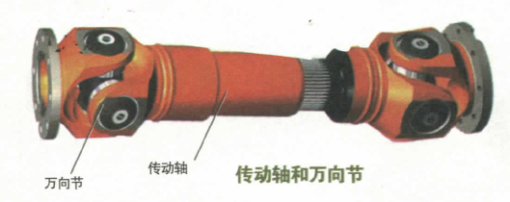
第一节 概 述
Section 1 Overview

Slide 4
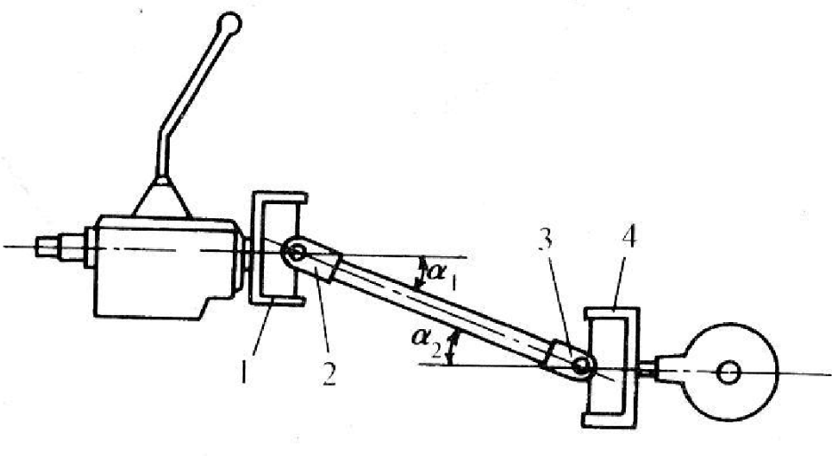
万向传动装置的组成
the components of universal gearing
组成：万向节与传动轴，当传动轴较长时还需加装中间支承。Components： universal joints and drive shaft，a center support bearing is used when the drive shaft is too long.
万向节 Universal joints
传动轴 Drive shaft

Slide 5
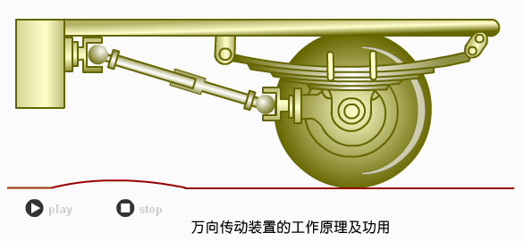
万向传动装置的功用
the function of universal gearing
功用：在轴线相交且相对位置经常变化的两转轴之间传递动力。Function：to transmit power between the shafts with variable angles and positions.

Slide 6
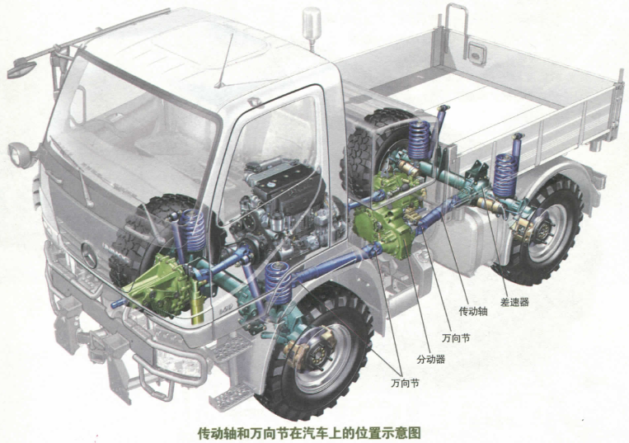
万向传动装置在汽车上的应用
The application of universal gearing on vehicles

Slide 7
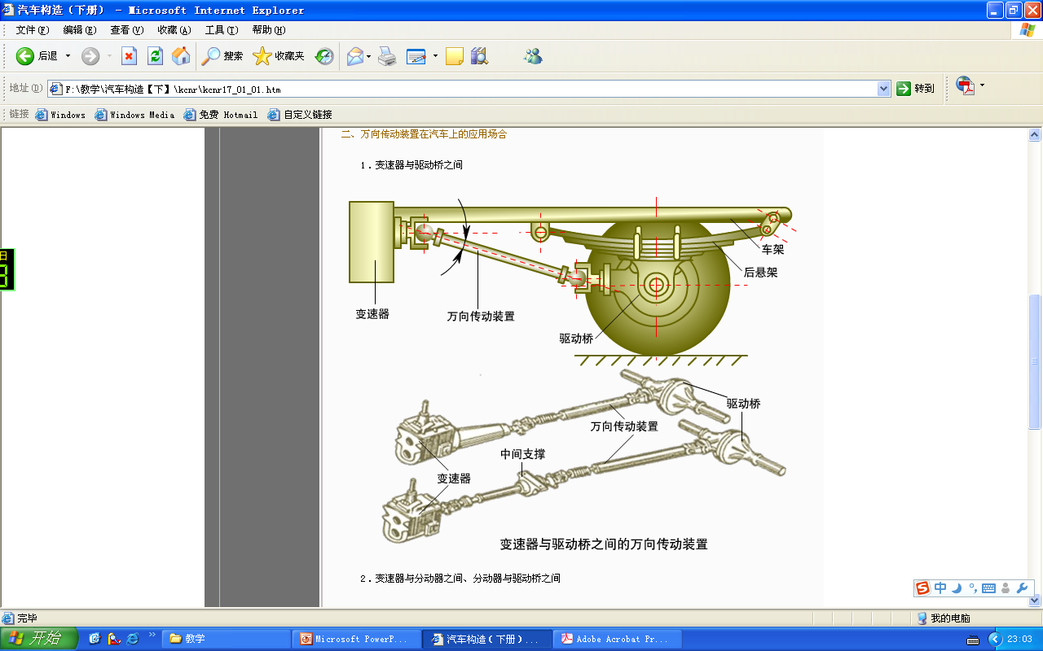
1. 变速器和驱动桥之间
1. Between the transmission and driving axle
变速器的输出轴与驱动桥的输入轴难以重合；The output shaft of transmission and the input shaft of driving axle are hard to be arranged in line ；
发动机的振动以及路面不平使得两轴相对位置经常变化。The relative location of the two shafts is always changed by the vibration of the engine and the rough road

Slide 8
2. 变速器和驱动桥之间
2. Between the transmission and driving axle
消除变速器与驱动桥之间的相对运动带来的不利影响。To eliminate the adverse effects of the relative movement of transmission and driving axle.
在变速器和驱动桥的距离较远时，将传动轴分成两段，并加中间支承，避免系统的共振、提高传动轴的临界转速和工作可靠性。
The drive line has two drive shafts and a center support bearing serves as a connecting link when there is a great distance between transmission and driving axle , in order to avoid resonance, increase the critical speed of the drive shaft and reliability

Slide 9
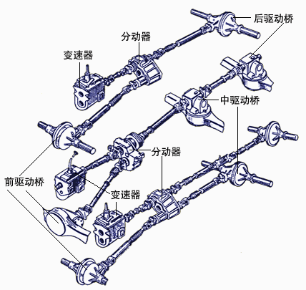
3. 变速器与分动器、分动器与驱动桥之间
3. Between the transmission and transfer case or between the transfer case and driving axle
在变速器与分动器分开安装的场合，二者之间存在制造和安装误差和车架变型引起的不利影响，因此采用万向传动装置。When the transmission and transfer case are mounted separately, the universal gearing is used to eliminate the installation errors, manufacturing errors and the deformation of car frame

Slide 10
4. 变速器与分动器、分动器与驱动桥之间
4. Between the transmission and transfer case or between the transfer case and driving axle
多轴汽车如果采用贯通式布置方案，中驱动桥与后驱动桥之间需采用万向传动装置。Multi-axle vehicles with tandem driveline use universal gearing to connect the middle driving axle and rear driving axle
多轴汽车如果采用非贯通式布置方案，其后桥传动轴需要加中间支承 。On multi-axle vehicles with parallel driveline, the rear drive shaft is equipped with a center support bearing

Slide 11
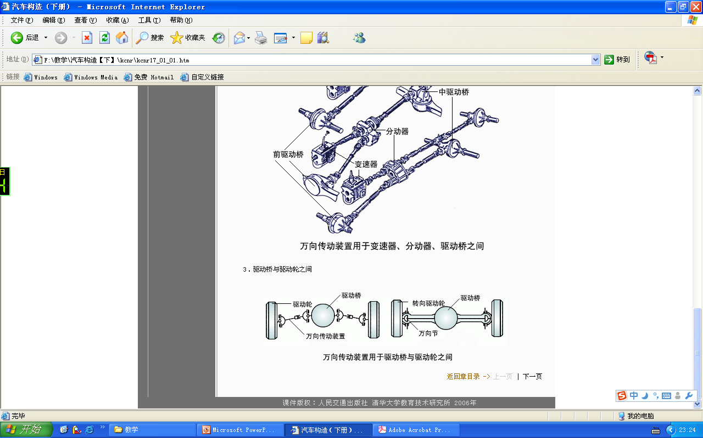
5. 驱动桥与驱动轮之间
5. Between driving axle and driving wheel
在转向驱动桥中需要该桥即能满足车轮转向又能不间断驱动力传递，因此在车轴靠近车轮处需要采用万向传动。In order to permit the wheel-steering and constant transmission of power, universal joints are mounted in the steering drive axle, beside the wheels
在采用独立悬架时，还需要在靠近主减速器处也要加万向节，满足左右半轴的跳动条件。On vehicles with independent suspension, universal joints are mounted close to final drive, to allow the two half-axles to move up and down

Slide 12
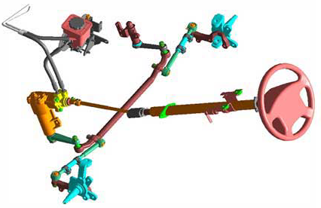
6. 动力输出装置和转向系统中
6. In the power supplying device
and steering system

Slide 13
第二节 万向节 Section 2 Universal joints
万向节的分类 The classification of universal joints
传动零件为弹性的，靠弹性零件的变形来消除部件之间的相对运动引起的不利影响，具有缓冲和减振作用。Transmission parts are elastic, so the elastic deformation is used to eliminate the adverse effects of relative movement between components and have the function of buffering and damping
用在两轴交角较小、只有微量相对运动位移的场合。Used when the changes in the angle and length of a drive shaft are slight
按在扭转方向上是否存在明显的弹性变形According to whether the elastic deformation of transmission parts with torque is apparent or not
挠性万向节 flexible universal joints
刚性万向节 rigid universal joints

Slide 14
第二节 万向节 Section 2 Universal joints
万向节的分类 The classification of universal joints
按在扭转方向上是否存在明显的弹性变型 According to whether the elastic deformation of transmission parts with torque is apparent or not
挠性万向节 flexible universal joints
刚性万向节 rigid universal joints
按运动特点According to the kinematic characteristics
不等速万向节Nonconstant velocity universal joints
准等速万向节Near constant velocity universal joints
等速万向节Constant velocity universal joints
传动零件为刚性的，靠刚性的铰链连接来传动动力。Transmission parts are rigid and the power is transmitted by rigid hinge

Slide 15
不等速万向节 Nonconstant velocity universal joints
特点：结构简单、传动可靠、效率高，允许两传动轴之间有较大的夹角（15~20度）；Characteristic: simple structure ,reliable and permit large angle between two drive shafts(15-20 °)；
最常见的不等速万向节为十字轴式刚性万向节。The most common type of nonconstant velocity universal joint is Cardan universal joint

Slide 16
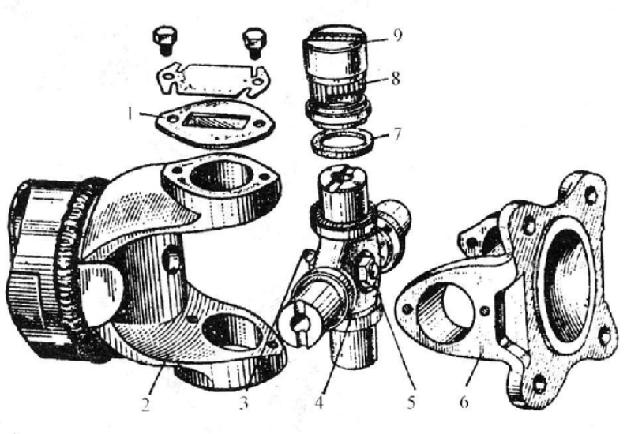
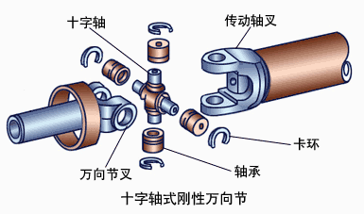
十字轴式刚性万向节的结构 The composition of Cardan universal joints
主要零部件：十字轴、万向节叉（两个）、滚针轴承、套筒、轴承盖、油封等。Main components: universal joint pin ,universal joint yokes(two), needle bearing, bearing cap, seal, etc.

Slide 17
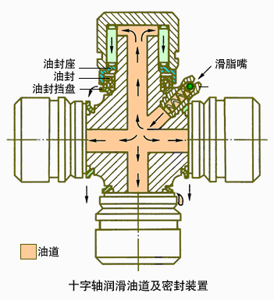
十字轴式刚性万向节的润滑与密封 The lubrication and sealing of Cardan universal joints
十字轴式万向节的损坏以十字轴轴颈和滚针轴承的磨损为标志。The abrasion of journals and needle bearings shows the damage of Cardan universal joints
现代十字轴万向节用橡胶油封代替了此前的毛毡和软木垫油封。Now the rubber seal is used to replace the former felt and cork seal on universal joints
当注油枪注入内腔的油压大于允许值时，多余的润滑油便从橡胶油封内圆表面与十字轴轴颈接触处溢出。The grease gun is used to fill the grease chamber and when the grease pressure is greater than the allowable pressure, the grease will spill from the contact surface between the rubber seal and journal

Slide 18
十字轴刚性万向节的不等速性 The speed variation of Cardan universal joints
单个万向节在输入轴和输出轴夹角不为零时，其两轴的瞬间角速度不相等。当输入轴匀速转动时，输出轴的转速周期性变化，我们称之为十字轴刚性万向节的不等速性。When the input shaft and output shaft of a universal joint are at an angle to each other, the instantaneous angular velocity of the two shafts are unequal. When the input rotates at constant speed, the speed of the output shaft changes periodically. This is the so-called speed variation of Cardan universal joints
原因：输入轴和输出轴之间存在的夹角。Reason: the input shaft and output shaft are at an angle to each other
结果：输出轴的速度不等于输入轴的速度，并呈周期性变化。Result: the output shaft doesn’t rotate at the same speed as the input shaft, and the speed of the output shaft changes periodically
影响：引起传动轴的扭转振动，并因此产生交变载荷，影响传动轴的寿命；并且交角越大时，两轴之间的不等速性越强烈。Influence: the speed variation causes torsional vibration and fluctuating torque and reduce the life of the drive shaft; the steeper the operating angle is , the greater the speed variation is.

Slide 19
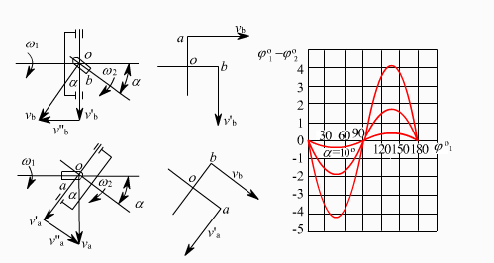
十字轴刚性万向节的不等速性 The speed variation of Cardan universal joints
如果主动轴以等角速度转动，则从动轴时快时慢，此即单个十字轴万向节在有夹角时传动的不等速性。If the input shaft speed is constant, the speed of the output shaft accelerates and decelerates to complete a single revolution, this is known as the speed variation of the single Cardan universal joint with a operating angle

Slide 20
十字轴刚性万向节的不等速性 The speed variation of Cardan universal joints
所谓不等速性是指从动轴旋转过程中角速度的不均匀；The so-called speed variation means the speed of the output shaft is not constant while rotating
在整个周期上，主从动轴的平均转速是相等的。The average speed of the input shaft and output shaft equals to each other during a same revolution

Slide 21
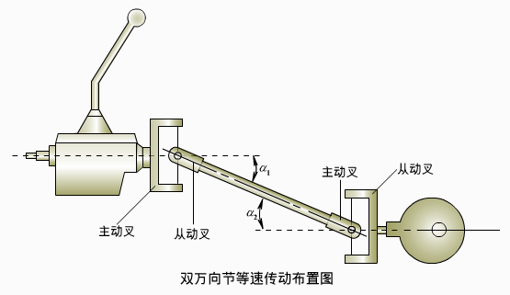
十字轴刚性万向节的等速条件 Constant velocity conditions for Cardan universal joints
采用双十字轴传动，使第一万向节的不等速效应被第二万向节的不等速效应所抵消，则可实现两轴间的等速传动。Drive shafts should have at least two universal joints, the speed variation of the front universal joint is offset by that of the rear universal joint, so that the uniform transmission is achieved

Slide 22
十字轴刚性万向节的等速条件 Constant velocity conditions for Cardan universal joints
等速条件 Conditions
第一万向节两轴夹角与第二万向节两轴夹角相等；The operating angles of the two universal joints equal to each other；
第一万向节从动叉与第二万向节主动叉在同一个平面。The driven yoke of the front universal joint and the driving yoke of the rear universal joint are in the same plane
驱动轮采用独立悬架时。The driving axle is equipped with independent suspension
传动轴与万向节的正确装配。The correct installation of the drive shaft and universal joints

Slide 23
双十字轴式刚性万向节的缺点 The disadvantage of double cross universal joints
尺寸大；Large dimension ；
为了保证较高效率，轴间夹角不能过大；The angle of a drive shaft between two universal joints can’t be too large, in order to ensure high efficiency
准等速万向节 Near constant velocity universal joints
等速万向节 Constant velocity universal joints

Slide 24
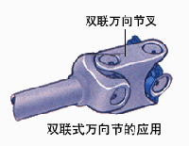
准等速万向节 Near constant velocity universal joints
常见的有双联式、三销轴式以及球面滚轮式。The commonly used type of near constant velocity universal joints are double Cardan universal joints, three-pin universal joints and spherical roller universal joints

Slide 25
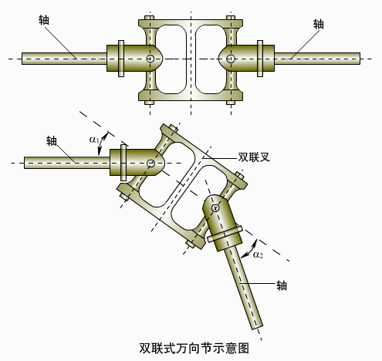
准等速万向节——双联式万向节 Near constant velocity universal joint ——double Cardan universal joints
等速原理：双十字轴式万向节的等速条件。Theory: constant velocity conditions for double cross universal joints
两个十字轴式万向节相连，中间传动轴长度缩减至最小。Two Cardan universal joints are connected and the drive shaft is reduced to the minimum
工作特点：轴交点位置协调变化。Characteristic: the intersection point of the rotational axes changes harmonically

Slide 26
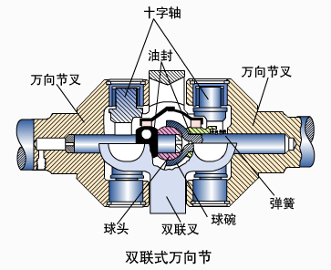
准等速万向节——双联式万向节 Near constant velocity universal joint ——double Cardan universal joints
优点：允许有较大的轴间夹角，轴承密封性好、效率高、制造工艺简单、加工方便、工作可靠等。多用于越野汽车 。Advantages：permit large operating angles, good sealing of bearings, high efficiency, easy to manufacture and process, reliable and often installed on off-road vehicles
在双联叉平分两轴间的夹角情况下，可实现等速传动。Uniform transmission can be achieved when the angle of two drive shafts is divided equally
一般设置分度机构保证两轴与传力点连线的夹角接近相等，从而使两轴的速度差尽量小。Dividing mechanism is normally used to ensure that the two joints operate at the same angle, so that the speed variation can be as slight as possible

Slide 27
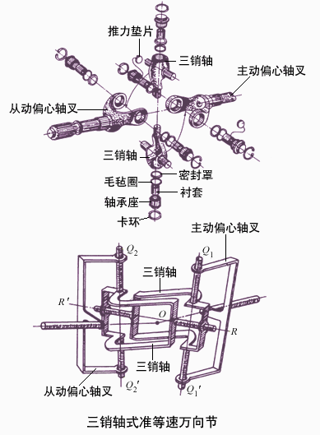
准等速万向节——三销轴式万向节 Near constant velocity universal joint ——Three-pin shaft universal joints
三销轴的两个轴通过轴承插入万向节叉的销孔中。The two journals with bearings are fitted into the universal joint yokes
由于结构上的原因，无法保证传力点永远处在两轴交角的平分线上。Because of the structure, it’s impossible to ensure that the points which transmit the power are on the angle-bisecting line all the time
允许两轴有较大的夹角（达45度），结构简单，体积大，只适用于安装在商用车前驱动桥的车轮处。Bermit large operating angles (up to 45 º),simple structure, large size, only used to connect the front drive axles and wheels of commercial vehicles

Slide 28
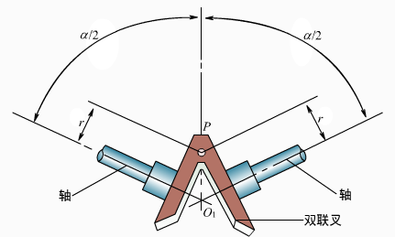
等速万向节 Constant velocity universal joints
等速原理：在结构上保证万向节在工作过程中，其传力点永远位于主从动轴交线的平分面上。Theory: the structure of the universal joints ensures that the points which transmit the power are in the angle-bisecting plane of the driving and driven shafts all the time
广泛应用的主要有球叉式万向节和球笼式万向节。The commonly used types of CV joints are Weiss universal joints and Rzeppa universal joints
在P点处两齿轮的圆周速度是相等的。The velocity of two gears equals to each other at the point P

Slide 29
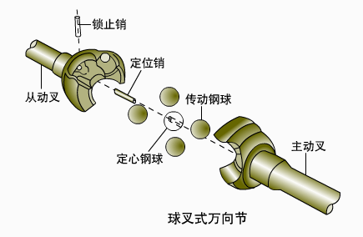
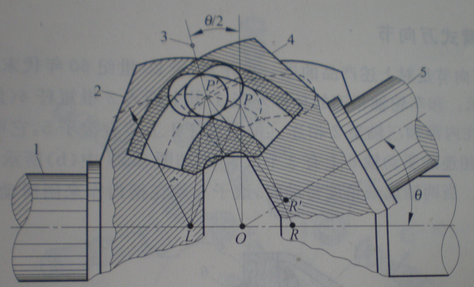
等速万向节——球叉式等速万向节 Constant velocity universal joint ——Weiss universal joints
主要部件：主动叉、从动叉、传动钢球、定心钢球、定位销等。Main components: driving yoke, driven yoke, driving balls, centering ball, dowel pin,etc
球叉的每一臂两边都磨有一球槽，球槽的球心在各自的轴线上；There are two ball tracks on each arm of the driving and driven yokes and the centers of ball tracks are on the axes of the input and output shafts
定心钢球用于确保两球叉之间的距离。The centering ball is used to ensure the distance between two yokes
P点在任何位置都能保证∠OPL=∠OPR，从而使球叉式万向节作等速传动。∠OPL=∠OPR is ensured wherever the point P is, so that the uniform transmission is achieved

Slide 30
等速万向节——球叉式等速万向节小结Summary of constant velocity universal joint ——Weiss universal joints
从结构上实现了两轴的转速相等；The structure of universal joints ensures the uniform transmission ；
最大转角32~35度，适合于转向驱动桥中；The largest operating angle is 32~35 º, suitable for steering drive axles；
传递转矩时只有上下两个钢球工作，寿命短，钢球与凹槽的磨损快。Only the upper and lower balls are at work while transmitting the torque, short life, large abrasion between balls and ball tracks
采用压力装配的球叉式等速万向节的拆卸不便。Not easy to disassemble and assemble because of the press fitting of Weiss universal joints

Slide 31
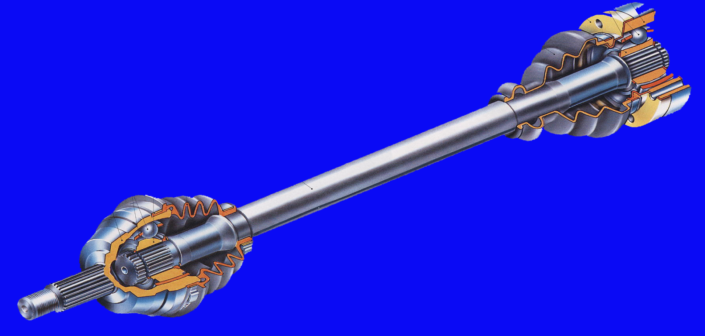
等速万向节——球笼式等速万向节
Constant velocity universal joint ——Rzeppa universal joints
按主、从动叉在传递转矩的过程中是否产生轴向位移 According to whether there is axial displacement while transmitting the torque
固定型球笼式万向节（RF节）Fixed joints of Rzeppa type(RF joint)
伸缩型球笼式万向节（VL节）Plunging joints of Rzeppa type(VL joint)
RF节
VL节

Slide 32
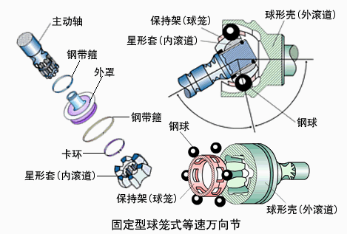
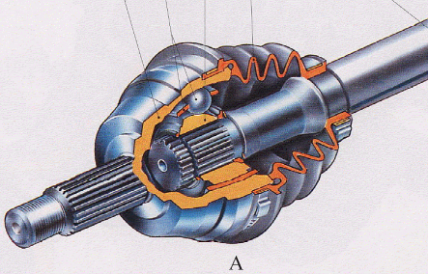
等速万向节——固定型球笼式等速万向节
Constant velocity universal joint ——fixed joints of Rzeppa type
主要部件：球形壳（外滚道）、传动钢球、保持架（球笼）、行星套（内滚道）等。Main components：outer race (outer track), balls, ball cage, inner race(inner track), etc

Slide 33
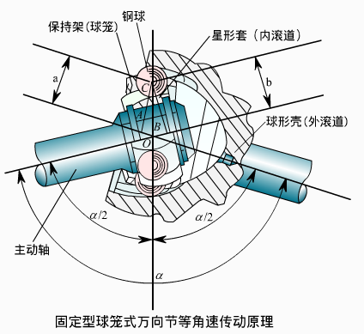
等速万向节——固定型球笼式等速万向节等速原理
The theory of constant velocity for fixed joints of Rzeppa type
钢球外滚道中心A，钢球外滚道中心B，AO=BO ；A is the center of the outer track , B is the center of the inner track，AO=BO ；
CA=CB，
∠COA=∠COB
两轴相交任意角a时，传力钢球的中心C都位于夹角的平分面上。However large the angle α is, the center of the driving ball is always on the angle-bisecting plane of the two shafts

Slide 34
等速万向节——固定型球笼式等速万向节的特点
The characteristic of the fixed joints of Rzeppa type
允许两轴间的夹角较大45~50度，适合于用在转向驱动桥的车轮侧；Permit large operating angle 45~50 º，suited to be mounted beside the wheels of vehicles with steering drive axle；
与球叉式相比：承载能力强，结构紧凑，拆卸方便；Compared with the Weiss universal joints: a greater torque capacity, a more compact structure，easier to disassemble and assemble；
制造精度要求高；Require high manufacturing accuracy；
应用日益广泛。Widely used nowadays

Slide 35
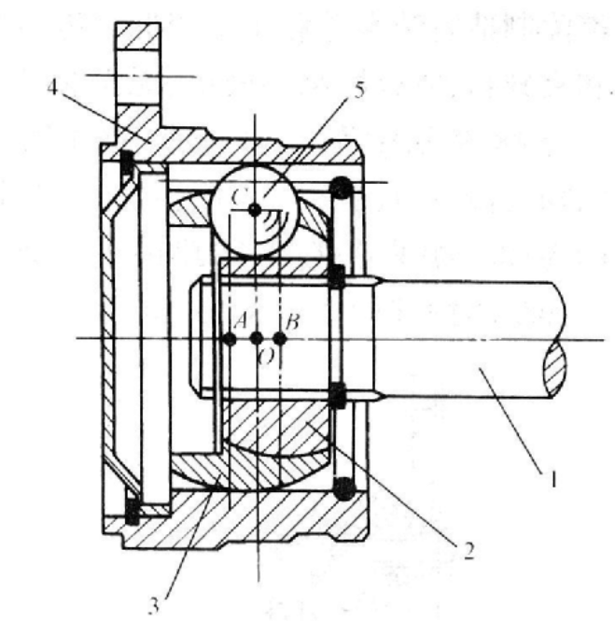
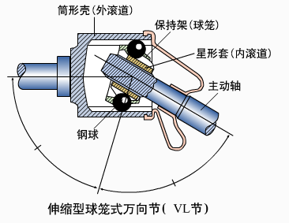
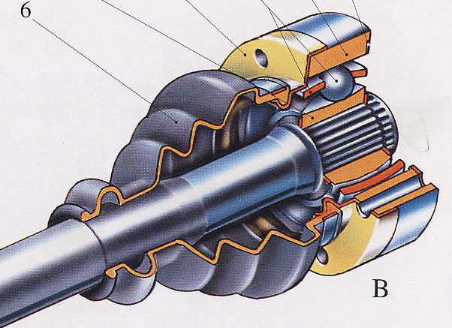
等速万向节——伸缩型球笼式等速万向节
Constant velocity universal joint ——plunging joints of Rzeppa type
内、外滚道均为柱面；The inner and outer tracks are roof-shaped；
主动轴、星形套、保持架一起可相对筒形壳４移动 Permit relative movement between the outer race and the combination of the driving shaft, inner race and ball cage

Slide 36
等速万向节——伸缩型球笼式等速万向节
Constant velocity universal joint ——plunging joints of Rzeppa type
保持架内球面中心B ，外球面中心A，位于万向节中心O的两边，且AO=BO；B is the center of the inner track, A is the center of the outer track, and AO=BO；
结构上6个传力钢球所确定的平面中心即为万向节中心，且CA=CB。The center of the plane determined by the six balls is also the center of the universal joint, and CA=CB。

Slide 37
等速万向节——伸缩型球笼式等速万向节的特点
The characteristic of the plunging joints of Rzeppa type
在传递转矩过程中，主从动轴不仅能相对转动，而且可以产生轴向位移。Permit axial displacement between the driving and driven shafts while transmitting the torque,
允许两轴间的夹角较大20~25度，Permit large operating angle 20~25 º，
承载能力强，结构紧凑，拆卸方便。High torque capacity, compact structure and easy to disassemble and assemble.

Slide 38
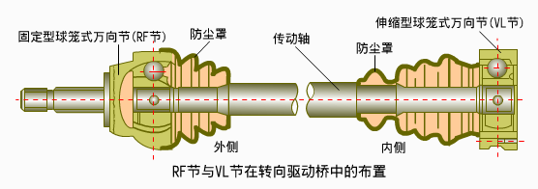
RF节和VL节的应用
The applications of the RF joints and VL joints
RF节用于靠近车轮处，VL节用于靠近驱动桥处。The RF joints are mounted beside the wheels，the VL joints are fitted close to the final drive
为什么？
Why？
思考Question

Slide 39
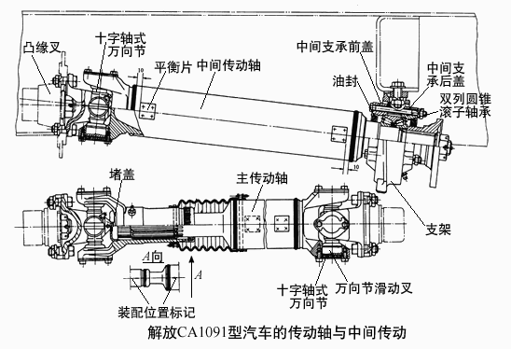
第三节 传动轴和中间支承 Section 3 Drive shafts and Center support bearings
传动轴结构
The composition of drive shafts
主要组成：传动轴、花键轴、滑动叉、中间支承、万向节叉等。Main components: drive shafts, splined shafts, sliding yoke, center bearings, universal joint yokes, etc

Slide 40
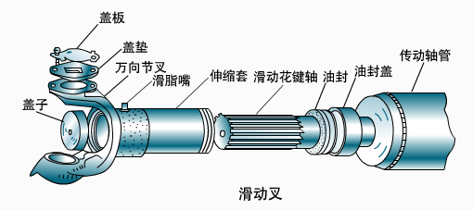
滑动叉的作用
The function of sliding yokes
在汽车行驶过程中，变速器与驱动桥的相对位置经常变化；As the car runs on the road, the relative distance between the transmission and driving axle often changes;
为避免运动干涉，在传动轴中设有滑动叉和花键轴组成的滑动花键连接，以适应传动轴长度变化的需要。A slip joint consisting of a sliding yoke and a splined shaft is used at one end of the drive shaft, in order to avoid the movement interference and permit the effective length of the drive shaft to change

Slide 41
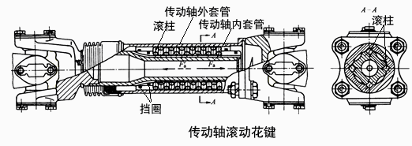
滑动叉的作用
The function of sliding yokes
有些汽车在花键槽内设有滚动原件，以减少摩擦和磨损。On some vehicles there are rolling elements in the internal spline, in order to reduce the friction and abrasion

Slide 42
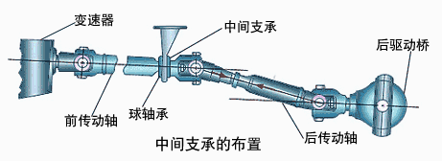
中间支承的作用 The function of intermediate support bearings
传动轴过长时，固有频率会降低，容易产生共振，故将其分成两段，并加设中间支承；The natural vibration frequency is low when the drive shaft is too long, so in order to prevent the drive shaft reaching its own frequency while rotating, a two-piece drive shaft is used and a intermediate support bearing serves as the connecting link between two pieces
前段称为中间传动轴，后段称为后传动轴。The front shaft is called intermediate drive shaft, the rear shaft is called main drive shaft

Slide 43
中间支承的作用 The function of center support bearings
中间支承安装在车架横梁和车身底架上，以补偿传动轴轴向和角度方向的安装误差以及车辆行驶过程中由于发动机窜动和车架变形引起的位移。The center support bearing is secured to a cross member of the frame or underbody and used to compensate the axial and angular installation error of the drive shaft , the displacement caused by the play of the engine and the deformation of the car frame when the car runs on the road

Slide 44
本章学习重点
Main points of Chapter 17
几种万向节传动装置的典型结构形式，汽车上的适用场合；The compositions and applications of some typical universal joints;
单十字轴万向节的不等速特性；The speed variation of single Cardan universal joints；
万向节的等速特性。The uniform transmission of universal joints

Slide 45
作业 Homework
双十字轴万向节传动的等速条件是什么？
What is the constant velocity conditions for double cross universal joints?
十字轴式万向节中滚针轴承的滚针在工作中作何种运动？滚针轴承的轴向定位方式主要有哪几种？各有什么优缺点？How do the needles of the needle bearings move when Cardan universal joint is working? How many kinds of methods are used to retain the needle bearings? What are their advantages and disadvantages ?
在转向驱动桥中，靠近主传动一侧布置的VL节能否去掉？若VL节与RF节的位置能否互换？为什么？
Whether the VL joint mounted in the steering drive axle, close to the final drive can be canceled or not? Whether the positions of VL joint and RF joint can be exchanged with each other? Why?

